Slide 1
End of Key Stage 1
Statutory Assessments
2023

Slide 2
Assessment at WBIS
Assessment is part of our everyday practice at West Bridgford Infant School. We are continually assessing children’s knowledge, skills and understanding and use this to identify their gaps in learning and their next steps. This is used to inform our planning on a lesson by lesson, day by day and week by week basis.
Assessment takes many forms such as: asking children questions; observing children working with others or solving problems; talking through work with children; marking written work and sometimes written tests. At the end of each year your child’s teacher makes a Teacher Assessment judgement about their attainment based on a range of assessment evidence as previously described.
At the end of Key Stage One in Year Two we are additionally required to participate in national Statutory Assessment Tests (SATs).
The tests are intended to supplement our ongoing school based Teacher Assessments and act as an additional piece of evidence.
Teachers will take into consideration the outcomes of the tests when making their final Teacher Assessment judgements for year two children.

Slide 3
How will you know what your child has achieved?
The Statutory Assessments at the end of Year Two are a summative snapshot of your child’s achievement at that point in time.
What they do not tell you is the progress your child has made from the start of school or during this school year. For many children this has been exceptional and will be reflected in their report.
Whilst we have been working hard to ensure children catch up with any gaps in their early learning following the disruption of the pandemic, we have also been equally focused on ensuring they develop sound learning behaviours and addressing the wider impact of the pandemic such as lost social skills and increased emotional health needs.
We have to be aware that children’s attainment may not be what we know they might have achieved without the disruption.
Please remember that your child is only at the start of their learning journey. They have several more years of learning before assessments that are more critical to their future options such as GCSEs.

Slide 4
How will you know what your child has achieved?
At the end of the summer term you will receive your child’s annual school report. This will be similar to reports in previous years but will also give you information about your child’s attainment at the end of Key Stage One.
At the end of Key Stage One (Year Two) children’s attainment will be reported as:
WTS - Working Towards the Expected Standard;
EXS - Working at the Expected Standard; or
GDS - Working in Greater Depth within the Expected Standard.
Some children may be working below the expected standard and their attainment will be reported against Pre Key Stage 1 Standards.
Other children with Special Educational Needs may be working on a different curriculum and their attainment will be reported using the Engagement Model.
If your child is working on a different curriculum or below the expected standard, you will already have been made aware of this at parent meetings.

Slide 5
The SAT Assessments
At the end of Year 2, children will take assessments in:
Reading
Maths
English: Grammar, Punctuation and Spelling
Writing
All assessments take place in May this year.
The following slides give examples from past papers to help you understand what they look like.
The children have been familiarised with this type of question/layout in lessons.

Slide 6
Reading
The Reading Test consists of two separate papers:
Paper 1 – consists of a combined reading prompt and answer booklet. The paper includes a list of useful words and some practice questions for teachers to use to introduce the contexts and question types to pupils. The test takes approximately 30 minutes to complete, but is not strictly timed.
Paper 2 – consists of an answer booklet and a separate reading booklet. There are no practice questions on this paper. Teachers can use their discretion to stop the test early if a pupil is struggling. The test takes approximately 40 minutes to complete, but is not strictly timed.
The texts will cover a range of poetry, fiction and non-fiction.

Slide 7
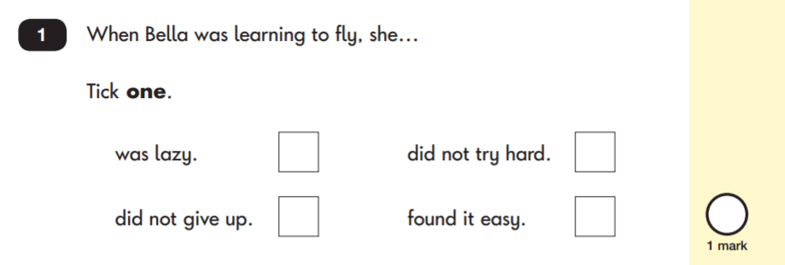
Reading: Sample Questions
Questions are designed to assess the comprehension and understanding of a child’s reading.
There are a variety of question types:
Multiple Choice

Slide 8
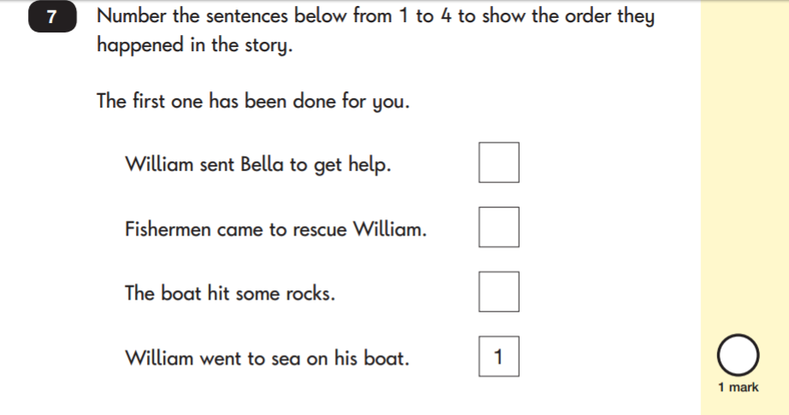
Reading: Sample Questions
Ranking/Ordering

Slide 9
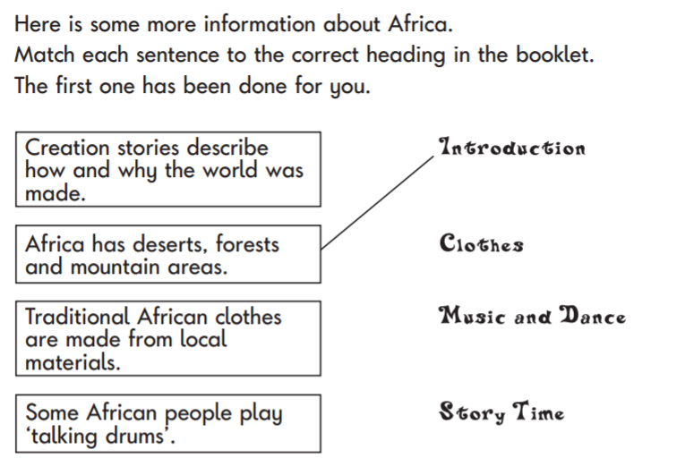
Reading: Sample Questions
Matching/Labelling
Short-Answer Questions

Slide 10
Reading: Sample Questions
Find and Copy Questions
Open-Ended Questions

Slide 11
Spelling, Punctuation and Grammar
This year, the Spelling, Punctuation and Grammar test will be optional for all Year 2 classes. School may still administer the assessment in order to inform their teacher-assessed writing judgements.
The test consists of two separate papers:
Paper 1: Spelling - pupils to spell 20 missing words within a test booklet. The test is expected to take approximately 15 minutes to complete, but is not strictly timed.
Paper 2: Grammar, Punctuation and Vocabulary - a combined question and answer booklet focusing on pupils’ knowledge of grammar, punctuation and vocabulary. Pupils will have approximately 20 minutes to complete the questions in the test paper, but it is not strictly timed.

Slide 12
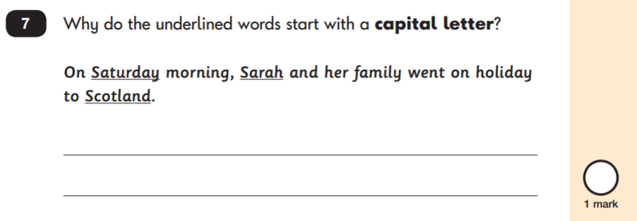
Grammar, Punctuation & Spelling: Sample Questions
Grammar, Punctuation and Vocabulary Paper

Slide 13
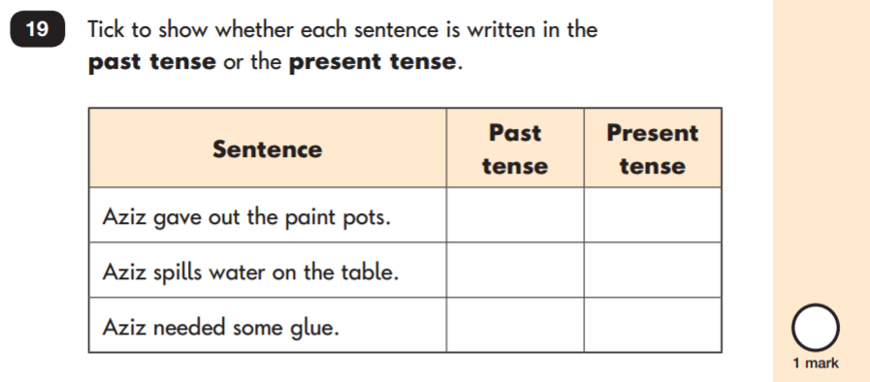
Grammar, Punctuation & Spelling: Sample Questions
Grammar, Punctuation and Vocabulary Paper

Slide 14
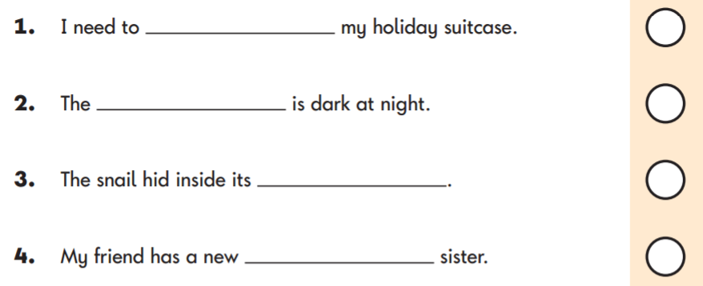
Grammar, Punctuation & Spelling: Sample Questions
Spelling Paper
Within the assessment, the spelling words are read out to the children to fill into the gaps within the sentences. In this example, the missing spelling words are: pack, sky, shell and baby.

Slide 15
Mathematics
Children will sit two tests: Paper 1 and Paper 2:
Paper 1: Arithmetic - lasts approximately 20 minutes (but this is not strictly timed). It covers calculation methods for all operations.
Paper 2: Reasoning - lasts for approximately 35 minutes, which includes time for five aural questions. Pupils will still require calculation skills and questions will be varied including multiple choice, matching, true/false, completing a chart or table or drawing a shape. Some questions will also require children to show or explain their working out.

Slide 16
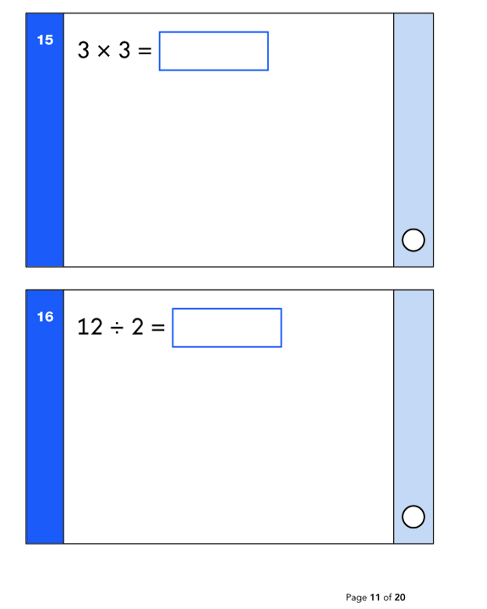
Maths: Sample Questions
Maths Paper 1: Arithmetic

Slide 17
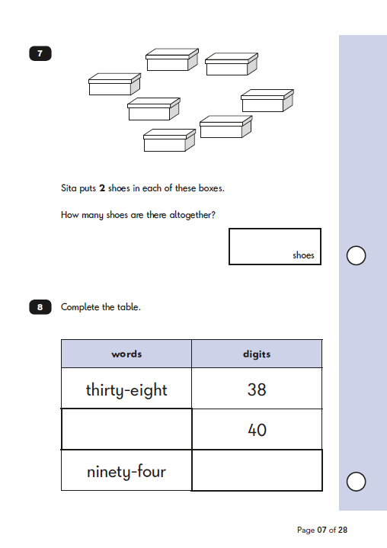
Maths: Sample Questions
Maths Paper 2: Reasoning

Slide 18
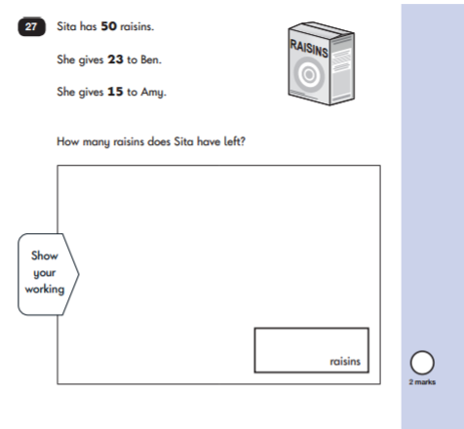
Maths: Sample Questions
Maths Paper 2: Reasoning

Slide 19
How to Help Your Child
First and foremost, support and reassure your child that there is nothing to worry about and that they should always just try their best. Praise and encourage!
Ensure your child has the best possible attendance at school.
Support your child with any homework tasks.
Reading, spelling and arithmetic (e.g. times tables) are always good to practise.
Talk to your child about what they have learnt at school and what book(s) they are reading (the character, the plot, their opinion).
Make sure your child has a good sleep and healthy breakfast every morning!

Slide 20
How to Help Your Child with Reading
Listening to your child read can take many forms:
First and foremost, focus developing an enjoyment and love of reading.
Enjoy stories together – reading stories to your child is equally as important as listening to your child read.
Read a little at a time but often, rather than rarely but for long periods of time!
Talk about the story before, during and afterwards – discuss the plot, the characters, their feelings and actions, how it makes you feel, predict what will happen and encourage your child to have their own opinions.
Look up definitions of words together – you could use a dictionary, the Internet or an app on a phone or tablet.
All reading is valuable – it doesn’t have to be just stories. Reading can involve anything from fiction and non-fiction, poetry, newspapers, magazines, football programmes, TV guides.
Visit the local library - it’s free!

Slide 21
How to Help Your Child with Writing
Practise and learn weekly spelling lists – make it fun!
Encourage opportunities for writing, such as letters to family or friends, shopping lists, notes or reminders, stories or poems.
Write together – be a good role model for writing.
Encourage use of a dictionary to check spelling.
Allow your child to use a computer for word processing, which will allow for editing and correcting of errors without lots of crossing out.
Remember that good readers become good writers! Identify good writing features when reading (e.g. vocabulary, sentence structure, punctuation).
Show your appreciation: praise and encourage, even for small successes!

Slide 22
How to Help Your Child with Maths
Play times tables games.
Play mental maths games including counting in different amounts, forwards and backwards.
Encourage opportunities for telling the time.
Encourage opportunities for counting coins and money e.g. finding amounts or calculating change when shopping.
Look for numbers on street signs, car registrations and anywhere else.
Look for examples of 2D and 3D shapes around the home.
Identify, weigh or measure quantities and amounts in the kitchen or in recipes.
Play games involving numbers or logic, such as dominoes, card games,
draughts or chess.
Use the White Rose App. You can download the app for free on the App store at the following link. https://whiterosemaths.com/resources/1-minute-maths

Slide 23
Summary
Please remember that your children are still very young. Some of them will still be 6! The Government only measures attainment in reading, writing and maths and this is more to do with measuring school performance than how well your child is doing. Children are unique. If they are reaching their individual potential we should be very proud of them.
We feel strongly that there are other equally important areas of your child’s learning and development which will enable them to become rounded individuals with key life skills which will equip them for adult life in a rapidly changing world. Please remember to celebrate their strengths in other areas such as being a confident and articulate speaker, having strong interpersonal skills, creative thinking, problem solving, artistic or physical talents etc.
A short video about the Key Stage One SATs can be found using the following link: https://www.youtube.com/watch?v=cuXJidYP7-0

